Slide 1
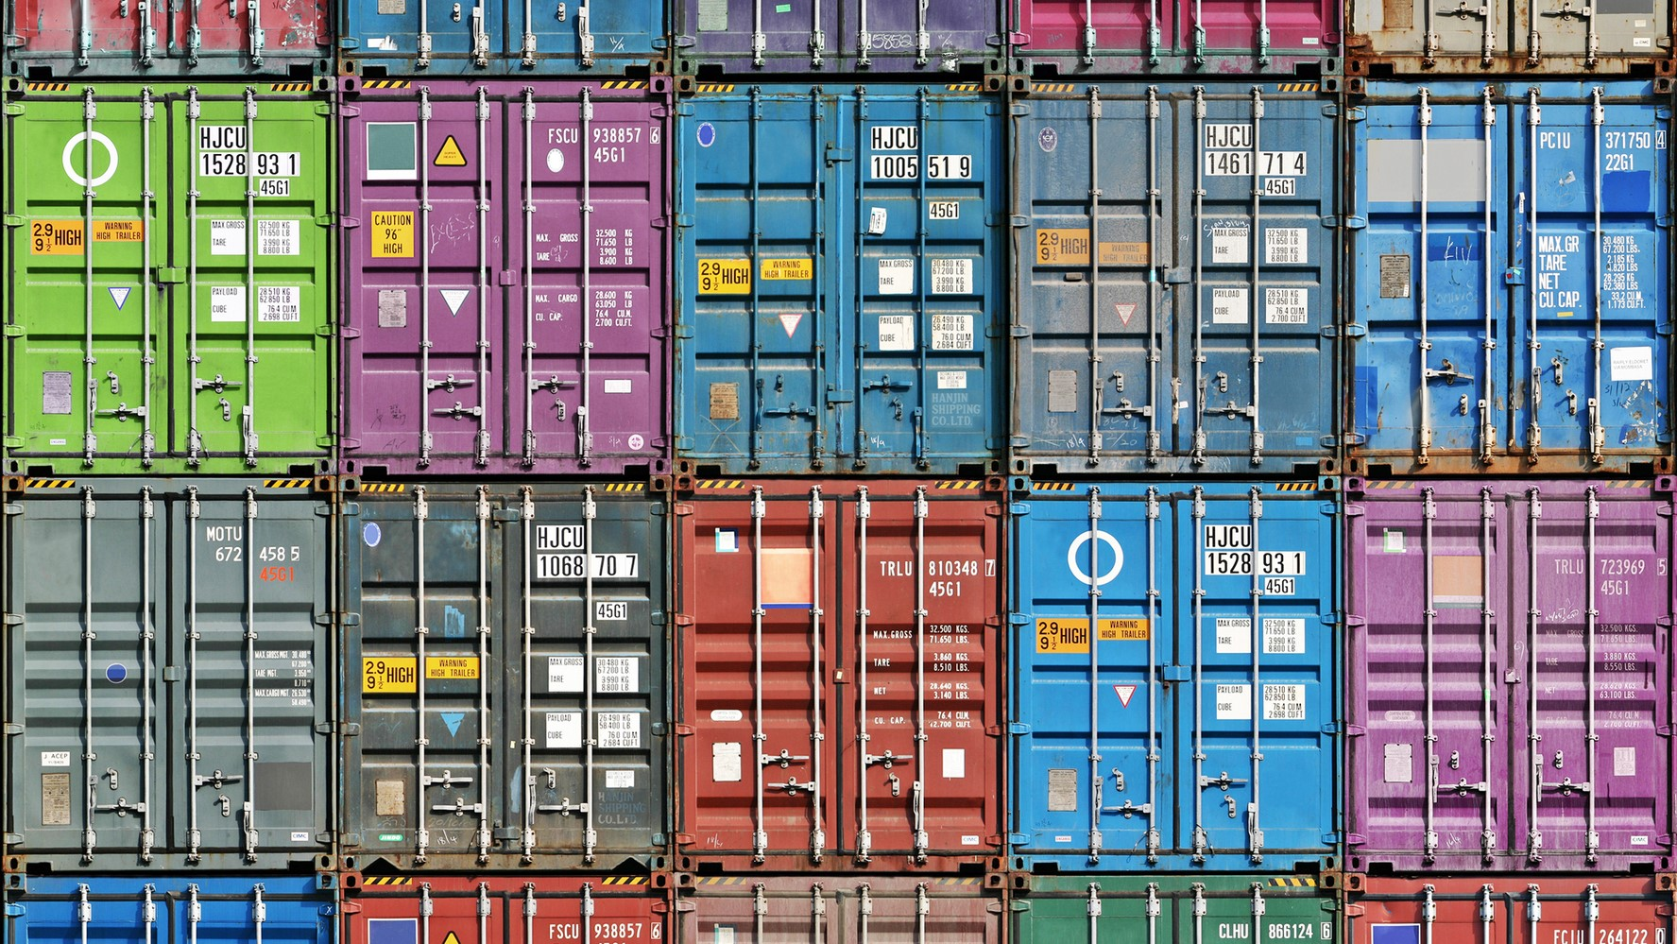
Docker Containers
Presentation by Marius Asadauskas & Julius Oeftiger
Fabrication and Prototyping in the Learning Lab
10.11.2022
Notes:
[image]: https://atlas-network.com/wp-content/uploads/2019/03/containers1-16.9.jpg

Slide 2
All problems in computer science can be solved by another level of indirection.
David Wheeler

Slide 3
Advantages
Subtitle
Subtitle
Add text, images, art, and videos.
Add transitions, animations, and motion.
Save to OneDrive, to get to your presentations from your computer, tablet, or phone.
Open the Design Ideas pane for instant slide makeovers.
When we have design ideas, we’ll show them to you right there.

Slide 4
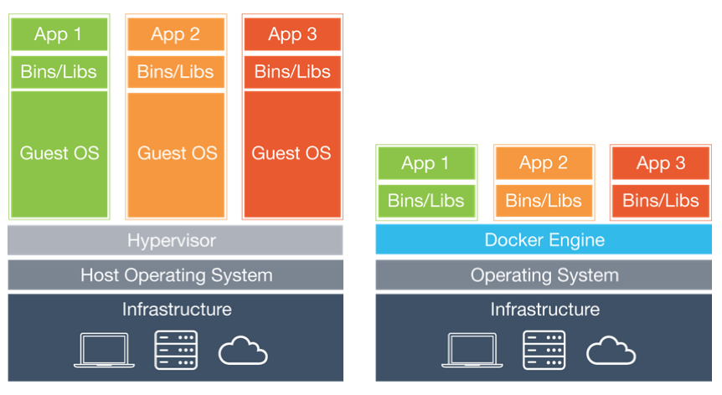
Docker vs Virtual Machines (Already seen)
Notes:
[Image]: https://stalk-calvin.github.io/img/20170415vd/docker.png

Slide 5
Security
Subtitle
Subtitle
Add text, images, art, and videos.
Add transitions, animations, and motion.
Save to OneDrive, to get to your presentations from your computer, tablet, or phone.
Open the Design Ideas pane for instant slide makeovers.
When we have design ideas, we’ll show them to you right there.

Slide 6
Content
Subtitle
Subtitle
Add text, images, art, and videos.
Add transitions, animations, and motion.
Save to OneDrive, to get to your presentations from your computer, tablet, or phone.
Open the Design Ideas pane for instant slide makeovers.
When we have design ideas, we’ll show them to you right there.

Slide 7
Project: PiHole
Subtitle
Subtitle
Add text, images, art, and videos.
Add transitions, animations, and motion.
Save to OneDrive, to get to your presentations from your computer, tablet, or phone.
Open the Design Ideas pane for instant slide makeovers.
When we have design ideas, we’ll show them to you right there.

Slide 8
Thank you for Listening
Any questions?

